Slide 1
Merge-Sort
EECS 233

Slide 2
Previous Lecture: Quick-Sort
Quick-Sort: a recursive, divide-and-conquer algorithm:
  divide: partition the array into two subarrays so that :
    each element in the left array <= each element in the right array
  conquer: apply quick-sort recursively to the subarrays, stopping when a subarray has a single element
  combine: nothing needs to be done, because of the criterion used in forming the subarrays
Implementation of Quick-Sort
  Choosing a good pivot value
  Partitioning procedure
  Recursive method
Analysis of Quick-Sort running time
  Best-case O(nlogn) and worst-case O(n²)

Slide 3
An exercise
i
j
0 1 2 3 4 5 6 7 8
16
8
13
2
9
15
4
12
24

Slide 4
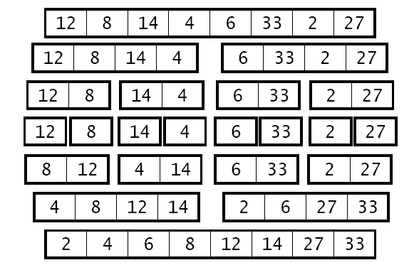
Merge-Sort
Like quick-sort, merge-sort is a divide-and-conquer algorithm.
  divide: split the array in half, forming two subarrays
  conquer: apply merge-sort recursively to the subarrays, stopping when a subarray has a single element
  combine: merge the sorted subarrays
Split
Split
Split
Merge
Merge
Merge

Slide 5
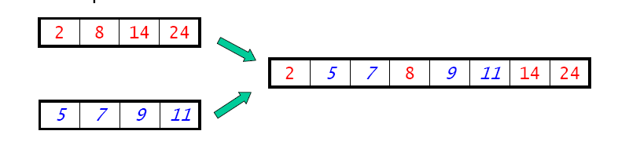
Merge-Sort
All of the sorting algorithms we've seen thus far have sorted the array in place. They used only a small amount of additional memory, i.e., O(logn) additional space (for recursion)
Merge-sort is a sorting algorithm that requires an additional temporary array of the same size as the original one.
  it needs O(n) additional space, where n is the array size
  space for merging two sorted arrays into a single sorted array.

Slide 6
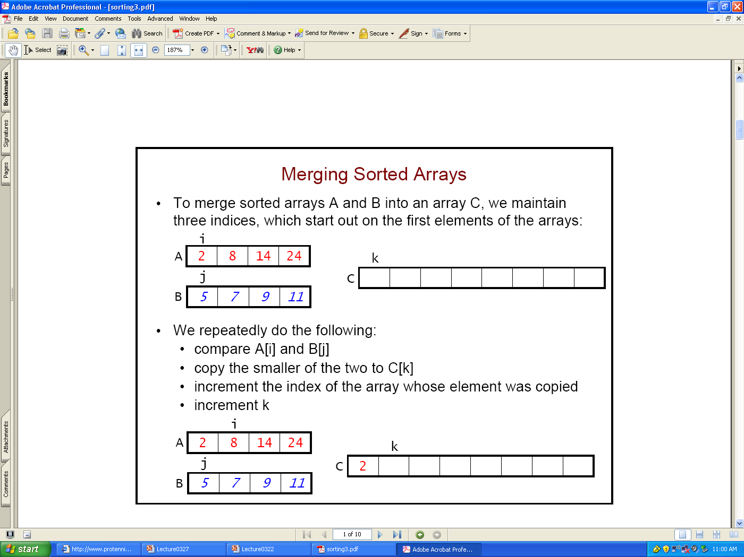
Merging Sorted Subarrays
To merge sorted arrays A and B into an array C, we maintain three indices, which start out on the first elements of the arrays:
We repeatedly do the following:
  compare A[i] and B[j]
  copy the smaller of the two to C[k]
  increment the index of the array whose element was copied
  increment k

Slide 7
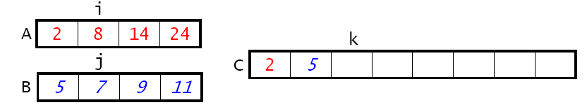
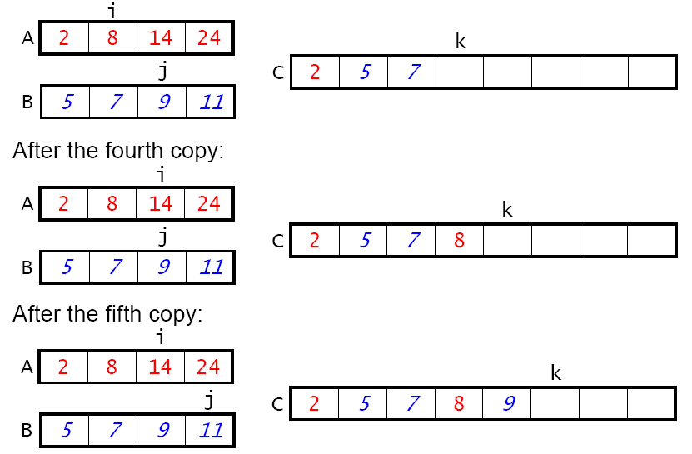
Merging Sorted Subarrays - Steps

Slide 8
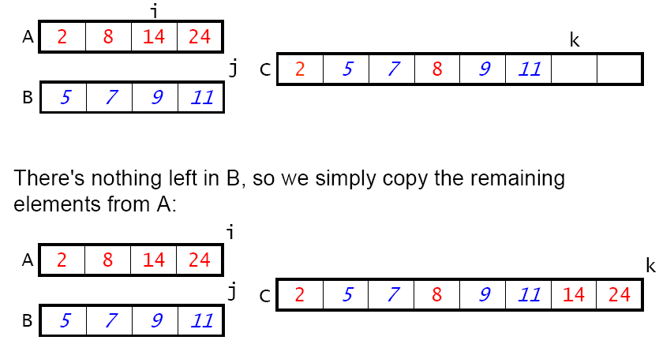
Merging Sorted Subarrays - Steps
Comparisons stop when either index reaches the end of its subarray
The remaining elements in the other subarray are copied to the combined array C

Slide 9
Recursive Procedure - Skeleton
Assume we have the merge() method, we will write a recursive method to implement the divide-and-conquer approach.
  static void mergeSort(int[] arr) {
    myMergeSort(arr);
  }
  static void myMergeSort(int[] arr) {
  if (arr.length == 1) return; // Base case
  // Allocate leftArr and rightArr
    split(arr,leftArr,rightArr);
    myMergeSort(leftArr);
    myMergeSort(rightArr);
    Merge(leftArr,RightArr,arr);
  }

Slide 10
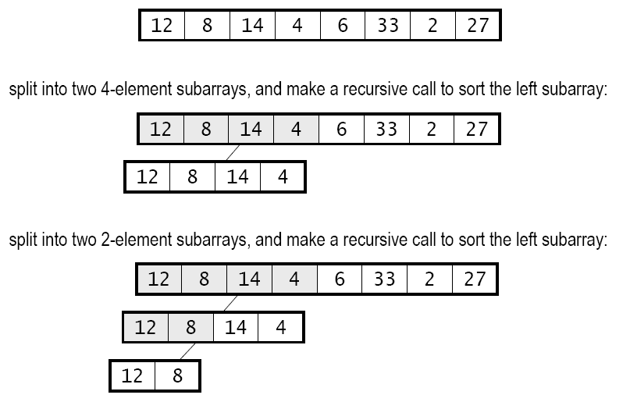
Recursive Calls - Steps
  static void mergeSort(int[] arr) {
    myMergeSort(arr);
  }
  static void myMergeSort(int[] arr) {
  if (arr.length == 1) return;
  // Allocate leftArr and rightArr
    split(arr,leftArr,rightArr);
    myMergeSort(leftArr);
    myMergeSort(rightArr);
    Merge(leftArr,rightArr,arr);
  }
Call to split:
Call to myMergeSort(leftArr)
Call to split:
Call to myMergeSort(leftArr)

Slide 11
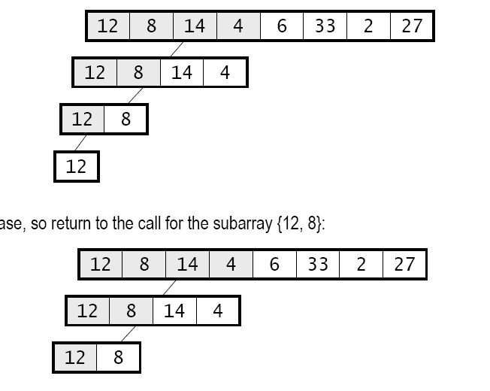
Recursive Calls - Steps
Further split it into two size-1 subarrays,
and issue recursive calls again
  static void mergeSort(int[] arr) {
    myMergeSort(arr);
  }
  static void myMergeSort(int[] arr) {
  if (arr.length == 1) return; // Allocate leftArr and rightArr
    split(arr,leftArr,rightArr);
    myMergeSort(leftArr);
    myMergeSort(rightArr);
    Merge(leftArr,rightArr,arr);
  }
We are down to the base cases, so simply return
(we have two sorted subarrays {12} and {8})

Slide 12
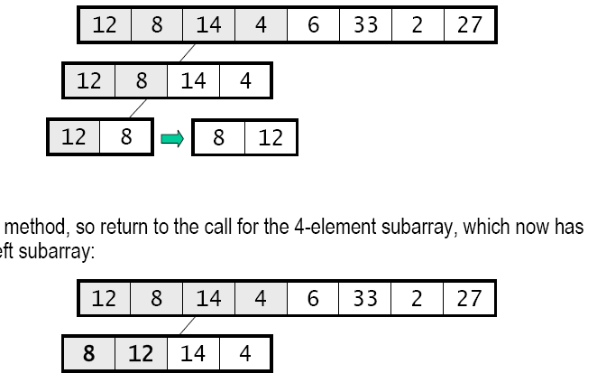
Recursive Calls - Steps
  static void mergeSort(int[] arr) {
    myMergeSort(arr);
  }
  static void myMergeSort(int[] arr) {
  if (arr.length == 1) return;
  // Allocate leftArr and rightArr
    split(arr,leftArr,rightArr);
    myMergeSort(leftArr);
    myMergeSort(rightArr);
    Merge(leftArr,RightArr, arr);
  }
Call merge() to merge two subarrays into
original array
Return to the recursive call for the 4-element subarray,
and start another recurise call for the right subarray {14, 4}.

Slide 13
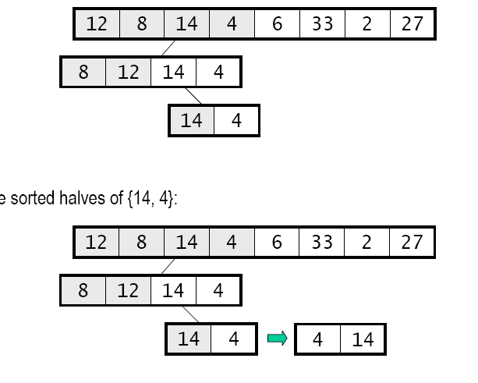
Recursive Calls - Steps
Repeat the similar process for the right 2-element subarray
  static void mergeSort(int[] arr) {
    myMergeSort(arr);
  }
  static void myMergeSort(int[] arr) {
  if (arr.length == 1) return;
  // Allocate leftArr and rightArr
    split(arr,leftArr,rightArr);
    myMergeSort(leftArr);
    myMergeSort(rightArr);
    Merge(leftArr,RightArr, arr);
  }

Slide 14
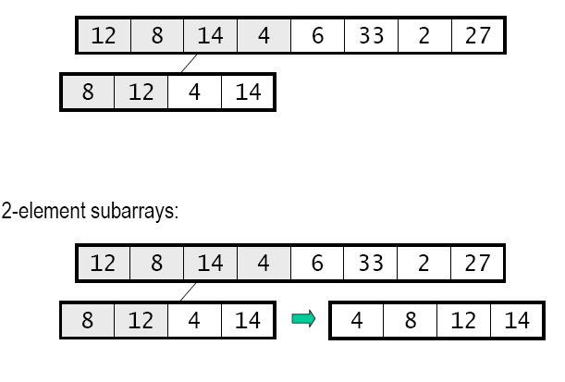
Recursive Calls - Steps
Return from the recursive call for the 2-element right subarray. We have
Call merge() to merge the 2-element subarrays, and copy the elements back
Etc.

Slide 15
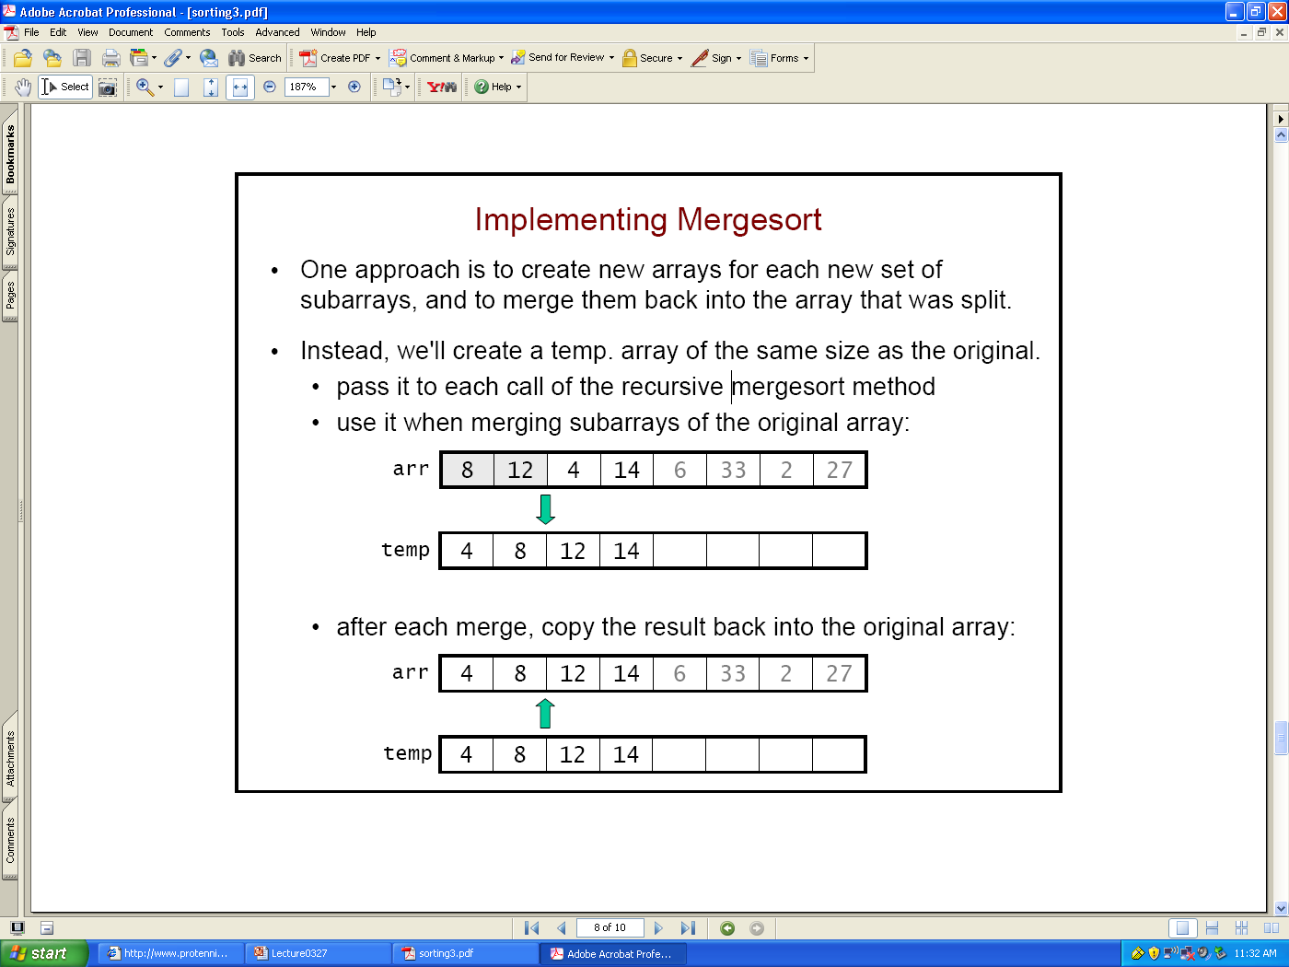
Implementation of Merge-Sort
Our approach so far was to create new arrays for each new set of subarrays, and to merge them back into the array that was split.
  Creates a lot of arrays in the recursive call chain
Instead, we'll create a temp. array of the same size as the original.
  pass it to each call of the recursive merge-sort method
  use it when merging subarrays of the original array:
  after each merge, copy the result back into the original array:

Slide 16
The Helper Method merge()
  static void merge(int[] arr, int[] temp, int leftStart, int leftEnd, int rightStart, int rightEnd) {
    int i = leftStart; // index into left subarray
    int j = rightStart; // index into right subarray
    int k = leftStart; // index into temp
    while ( ? ) {
    }
    ?
    for (i = leftStart; i <= rightEnd; i++) // copy back
      arr[i] = temp[i];
  }
leftStart leftEnd rightStart rightEnd
Notes:
while (i <= leftEnd && j <= rightEnd)
{
if (array[i] <= array[j])
{
temp[k] = array[i];
i++;
}
else
{
temp[k] = array[j];
j++;
}
k++;
}
/* Copy remaining elements of left array if any */
while (i <= leftEnd)
{
temp[k] = array[i];
i++;
k++;
}
/* Copy remaining elements of right if any */
while (j <= rightEnd)
{
temp[k] = array[j];
j++;
k++;
}

Slide 17
  static void merge(int[] arr, int[] temp, int leftStart, int leftEnd, int rightStart, int rightEnd) {
    int i = leftStart; // index into left subarray
    int j = rightStart; // index into right subarray
    int k = leftStart; // index into temp
    while (i <= leftEnd && j <= rightE) {
      if (array[i] <= array[j])
      {
      temp[k] = array[i];
      i++;
      }
      else
      {
      temp[k] = array[j];
      j++;
      }
      k++; }
    /* Copy remaining elements of left array if any */
        while (i <= leftEnd)
        {
        temp[k] = array[i];
        i++;
        k++;
        }
    /* Copy remaining elements of right if any */
    for (i = leftStart; i <= rightEnd; i++) // copy back
      arr[i] = temp[i];
  }
Notes:
while (i <= leftEnd && j <= rightEnd)
{
if (array[i] <= array[j])
{
temp[k] = array[i];
i++;
}
else
{
temp[k] = array[j];
j++;
}
k++;
}
/* Copy remaining elements of left array if any */
while (i <= leftEnd)
{
temp[k] = array[i];
i++;
k++;
}
/* Copy remaining elements of right if any */
while (j <= rightEnd)
{
temp[k] = array[j];
j++;
k++;
}

Slide 18
mergeSort()
We use a wrapper method to create the temporary array, and to make the initial call to a separate recursive method:
  static void mergeSort(int[] arr) {
    int[] temp = new int[arr.length];
    myMergeSort(arr, tmp, 0, arr.length - 1);
  }
  static void myMergeSort(int[] arr, int[] temp, int start, int end) {
    if ( ? ) // base case
      return;
    int middle = (start + end)/2; // The splitting step
    ?
  }
Notes:
if(start >= end)
return;
int middle = (start + end)/2; // The splitting step
// Sort first and second halves
myMergeSort (arr, temp, start, middle);
myMergeSort (arr , temp, middle+1, end);
// Merge the sorted halves
merge(arr, temp, start, middle, middle+1, end);

Slide 19
mergeSort()
  static void mergeSort(int[] arr) {
    int[] temp = new int[arr.length];
    myMergeSort(arr, tmp, 0, arr.length - 1);
  }
  static void myMergeSort(int[] arr, int[] temp, int start, int end) {
    if (start >= end ) // base case
      return;
    int middle = (start + end)/2; // The splitting step
      // Sort first and second halves
      myMergeSort (arr, temp, start, middle);
      myMergeSort (arr , temp, middle+1, end);
      // Merge the sorted halves
      merge(arr, temp, start, middle, middle+1, end);
  }
Notes:
if(start >= end)
return;
int middle = (start + end)/2; // The splitting step
// Sort first and second halves
myMergeSort (arr, temp, start, middle);
myMergeSort (arr , temp, middle+1, end);
// Merge the sorted halves
merge(arr, temp, start, middle, middle+1, end);

Slide 20
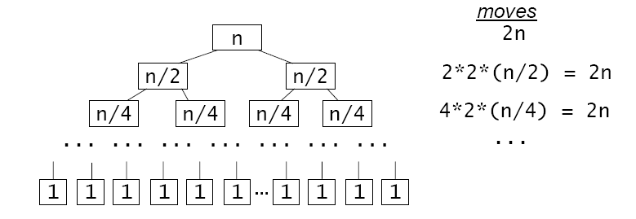
Running Time Analysis
Merging two halves of an array of size n requires 2n moves.
Merge-sort repeatedly divides the array in half, so we have the following call tree:
  recursive call tree for mSort() # moves
  At all but the last level of the call tree, there are 2n moves
    How many levels are there?
  M(n) = 2nlog₂n (worst-case or best-case)
  C(n) ≤ nlog₂n (between 0.5n*log(n) and n*log(n) )
  O(n log n) overall

Slide 21
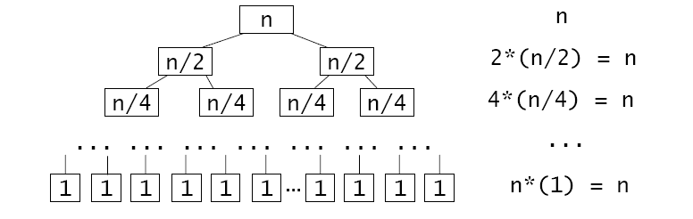
Compared to Quick-sort
Partitioning an array requires n comparisons, because each element is compared with the pivot.
best case: partitioning always divides the array in half
    recursive call tree for qSort() # comparisons
  at each level of the call tree, we perform n comparisons
  There are log₂n levels in the tree. So C(n) = nlog₂n
  M(n) ≤ 1.5 nlog₂n (at most n/2 swaps at each level)

Slide 22
Quick-Sort or Merge-Sort?
Quick-sort used often
  Low extra space
  Good performance average
For Quick-Sort
  worst-case does not appear often, average-case is closer to best-case (n*log(n) comparisons and 1.5n*log(n) moves)
  It is important to choose good pivots, to have n*log(n) running time
For merge-sort
  Average-case is close to worst-case
  Between 0.5n*log(n) and n*log(n) comparisons and 2n*log(n) moves

